Slide 1

Lead Score Case Study
Group Members
Arohi Malviya
Divya dixit

Slide 2
Problem Statement
X Education sells online courses to industry professionals.
▶ X Education gets a lot of leads, but its lead conversion rate is very poor. For example, if, say, they acquire 100 leads in a day, only about 30 of them are converted.
▶ To make this process more efficient, the company wishes to identify the most potential leads, also known as ‘Hot Leads’.
▶ If they successfully identify this set of leads, the lead conversion rate should go up as the sales team will now be focusing more on communicating with the potential leads rather than making calls to everyone.
Business Objective:
▶ X education wants to know the most promising leads.
▶ For that they want to build a model which identifies the hot leads.
▶ Deployment of the model for future use.

Slide 3
Solution Methodology
▶ Data cleaning and data manipulation.
Check and handle duplicate data.
Check and handle NA values and missing values.
Drop columns, if it contains a large number of missing values and is not useful for the analysis.
Imputation of the values, if necessary.
Check and handle outliers in data.
▶ EDA
Univariate data analysis: value count, distribution of a variable, etc.
Bivariate data analysis: correlation coefficients and pattern between the variables etc.
▶ Feature Scaling & Dummy Variables and encoding of the data.
▶ Classification technique: logistic regression is used for model making and prediction.
▶ Validation of the model.
▶ Model presentation.
▶ Conclusions and recommendations.

Slide 4
Data Manipulation
▶ Total Number of Rows =37, Total Number of Columns =9240.
▶ Since Prospect IDs are all unique, we can drop the same as it won’t be useful in the model building ahead. Similarly, Lead Number doesn't help in adding any unique attribute. Dropping the columns
▶ About 36.6% of leads have not mentioned their specialization, this can be due to many reasons such as the unavailability of the choice or case the lead is a student. Therefore, we can replace these NaN values with 'Not Specified’.
▶ Dropping the columns having more than 30% as a missing value.

Slide 5
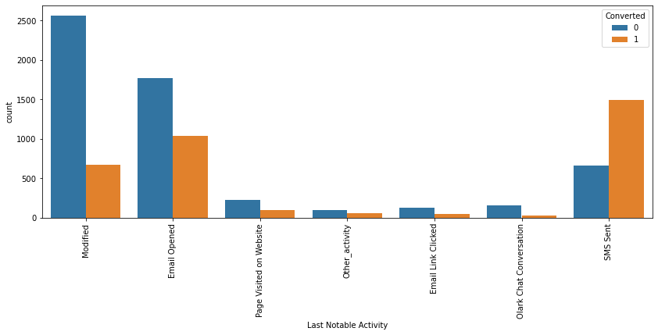
EDA

Slide 6
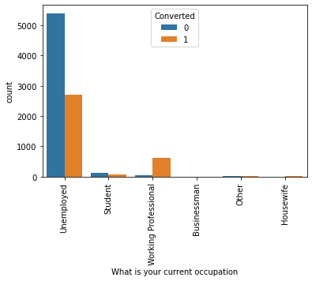
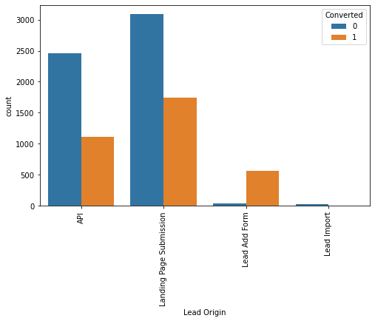
EDA

Slide 7
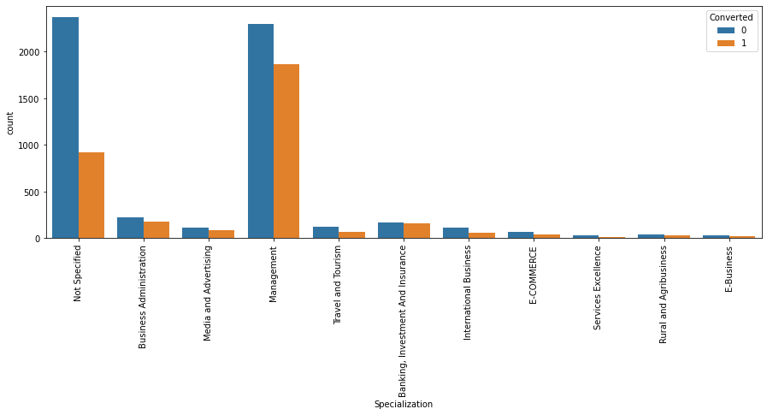
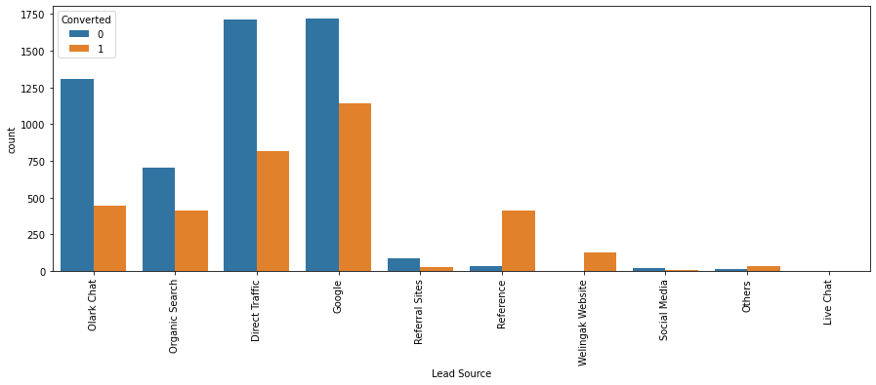
Categorical Variable Relation

Slide 8
Data Conversion
▶ Numerical Variables are Normalised
▶ Dummy Variables are created for object-type variables
▶ Total Rows for Analysis: 9028
▶ Total Columns for Analysis: 11

Slide 9
Model Building
▶ Splitting the Data into Training and Testing Sets
▶ The first basic step for regression is performing a train-test split, we have chosen a 70:30 ratio.
▶ Use RFE for Feature Selection
▶ Running RFE with 15 variables as output
▶ Building Model by removing the variable whose p-value is greater than 0.05 and VIF
Value is greater than 5
▶ Predictions on a test data set
▶ Overall accuracy 79.3%

Slide 10
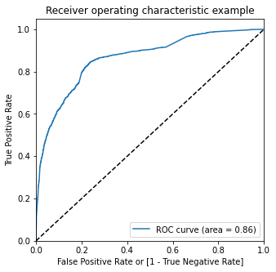
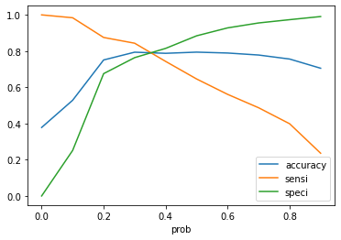
ROC Curve
▶ Finding Optimal Cut-off Point
▶ Optimal cut-off probability is that
▶ probability where we get balanced sensitivity and specificity.
▶ From the second graph it is visible that the optimal cut-off is at 0.37

Slide 11
Conclusion
Observation of Test Data
Accuracy: 79.3%
Sesititvity: 80.8%
Specificity: 78.34%
Comparision Between Train & Test data
rain Data vs Test Data
Accuracy: 79.83% vs 79.3
Sensitivity: 81.55% vs 80.8%
Specificity: 78.8% vs 78.34%
Overall, The Model seems to predict a Good Conversion Rate and therefore can be used ahead for narrowing the choices for leads and improving the enrollments

